Slide 1
Warm-up
The quote, “Aim for the moon. Even if you miss, you will land among the stars,” is true because if you aim higher in life, even if you don’t get exactly as high as you want, you will still have gone somewhere toward reading that goal.
If you were a freshman, and your goal was to finish high school, that would represent your moon. Suppose you only made it to your Junior year and you had to drop out. That would represent your stars. Even if you didn’t graduate, you are still more educated than you were when you were a freshman, and its still possible for you to get your GED.
Maybe your goal was to become a huge movie star, but you’ve never acted before. You could try out for some cheap commercials and then you might be known as “That chick who was in the ‘Doritos’ commercial.” You probably wouldn’t be a huge star, but you will have gained some recognition still.
You might have wanted to be the boss of a big corporation. You got promoted again, and again until the only job left until you reached the top would be your boss. He probably wouldn’t want to promote you into his job himself, but you got really close to your goal, you’re among the stars.
Or maybe your dream was to be the quarterback of your high school football team, and you worked and trained all summer for it. When try-outs came you only made offensive linebacker. At least you made the team, even if you didn’t quite reach your goal, and you can always try again next year.
A lesson you may learn from this quote is that as long as you try, you will get much farther in life than if you don’t try at all.
Read the essay above. Rate it from 1-4, 1 being the lowest and 4 being the highest, and explain your answer!

Slide 2
Warm-up
The quote, “Aim for the moon. Even if you miss, you will land among the stars,” is true because if you aim higher in life, even if you don’t get exactly as high as you want, you will still have gone somewhere toward reading that goal.
If you were a freshman, and your goal was to finish high school, that would represent your moon. Suppose you only made it to your Junior year and you had to drop out. That would represent your stars. Even if you didn’t graduate, you are still more educated than you were when you were a freshman, and its still possible for you to get your GED.
Maybe your goal was to become a huge movie star, but you’ve never acted before. You could try out for some cheap commercials and then you might be known as “That chick who was in the ‘Doritos’ commercial.” You probably wouldn’t be a huge star, but you will have gained some recognition still.
You might have wanted to be the boss of a big corporation. You got promoted again, and again until the only job left until you reached the top would be your boss. He probably wouldn’t want to promote you into his job himself, but you got really close to your goal, you’re among the stars.
Or maybe your dream was to be the quarterback of your high school football team, and you worked and trained all summer for it. When try-outs came you only made offensive linebacker. At least you made the team, even if you didn’t quite reach your goal, and you can always try again next year.
A lesson you may learn from this quote is that as long as you try, you will get much farther in life than if you don’t try at all.
Read the essay above. Rate it from 1-4, 1 being the lowest and 4 being the highest, and explain your answer!

Slide 3
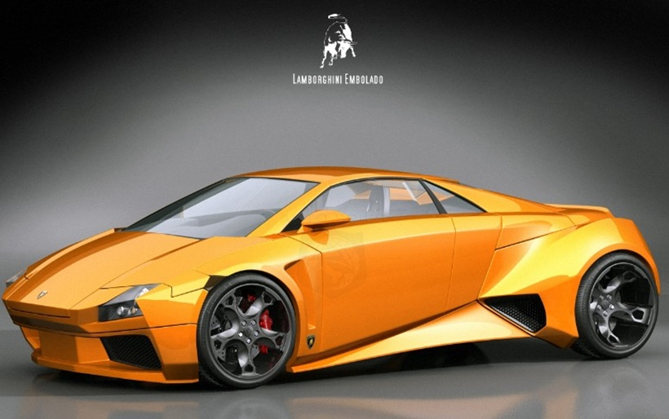
$382,400
This is an “Above Standards” paper. It is the best of the best. People notice it and are envious of how beautiful and stylish it is.

Slide 4
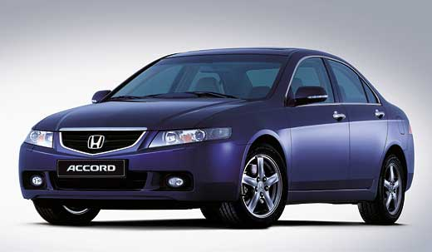
$21,499
This is a “Meets the Standards” paper. It is solid with 5 developed paragraphs. It has some real shining moments. Although, it could still be improved to an “Above Standards” paper.

Slide 5
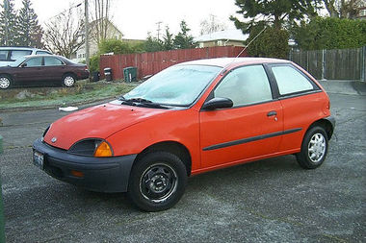
$1,153
This is an “Approaching Standards” paper. It is basic and a little bit sad; it could even be missing minor parts. It sputters and sometimes you might need to stop and give it a push. It could use some major improvements.

Slide 6
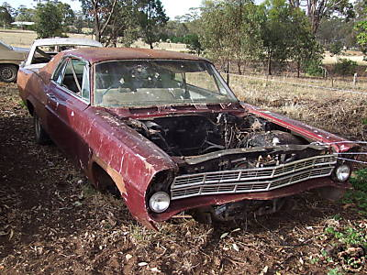
They pay you to haul this away
This is a “Below Standards” paper. It has the most basic bones of an idea, but it isn’t going to go anywhere. It will take a bunch of time and effort to rebuild and improve this one. Many parts are missing, and the ones that are there are broken.

Slide 7
Create your own analogy.
With your shoulder partner, create a different analogy to help you remember the writing rubric scale.

Slide 8
Time to practice
In a group, you will read and score five papers using the writing rubrics.

Slide 9
Above
Meets
Approaching
Below
In the corner of each post-it note, write Above, Meets, Approaching, or Below to grade for content.
Next, use words from the rubric to explain your scoring. (Write at least 2 examples to explain)
Put the writing responses in order from Above to Below.

Slide 10
The Post-Its should look like this..
3
The paper has a topic but it could be more developed.
The reader if left with a few questions.
Write your score in the upper right-hand corner.
Write at least two points from the rubric on each post-it!
The information should be bulleted.
Everyone must help write the post-its.
Because you are quoting from the rubric, spelling should be correct.

Slide 11
Good Afternoon Ms. Stayner,
Imagine a thick brown haze of air covering the country. The seasons no longer change into fall and winter. Our climate is stuck in boiling, hot summer. Many animal populations have died out and humans spend most of their time indoors to avoid the hot, thick, polluted air. Global warming is not a myth, but it is something that affects every living organism in the world. If we do not go green, the Earth will become a 100 degree polluted landfill. We, the people of Earth, need to know what to do to save our planet. The children of today will be the adults of tomorrow; that is why climate change is the most important topic we have studied in science.
As research shows, global warming occurs when the atmosphere traps greenhouse gases. When too much of it is trapped, the gases cause the atmosphere to get warmer. Scientists know that when too much pollution is let out in the air it turns bad. The carbon dioxide then gets trapped within the clouds.
Global warming is important because it affects us all. The climate is changing which means in the summer the temperatures are going up. As the warmth is constantly on the rise, the polar ice caps are melting. Many animals such as polar bears are finding it hard to find food. Polar bears are already listed as endangered.
If we want to stop global warming, we should reuse, reduce, and recycle more. Recycling keeps trash out of landfills where it simply rots away. Also, recycling helps save trees. We should not throw items away that can be recycled or reused. Instead of driving your car and causing more pollution, you should take the bus or ride your bike to your destination.
Imagine a world with clean air and lush green plants. This is a world without global warming. Global warming is important because it does not affect just people in Bentonville, but every single person and all animals and plants. If we are ever going to get rid of global warming, it is important to understand what causes it and what we can do to stop it.
Thank you for teaching us so much about global warming.
Student

Slide 12
 Exit Slip
On a slip of paper, answer the following in complete sentences:
What is the importance of using a rubric?
List at least two examples of ways you can improve your writing based on what you learned from the rubric today.

Slide 13
Take out a piece of notebook paper
Put your name on it.
Read your essay.
1. Write the score you got
2. Write a complete sentence
explaining if you agree or
disagree. Tell me why!
3. With complete sentences, explain
three things you could have done
to improve your paper.
1—Yellow
2—Pale Purple
3—Aqua
4—Tan
Use the Rubric!

